Slide 1
Type 1 diabetes management and technology
Prof. Paolo Pozzilli
Unit of Endocrinology & Diabetes Campus Bio-Medico University Rome, Italy
Centre of Immunobiology, Barts & The London School of Medicine, UK
Editor in Chief, Diabetes Metabolism Research and Reviews

Slide 2
DISCLOSURE STATEMENT 2024 Speakers Name: Prof. Paolo Pozzilli  I have the following potential conflicts of interest to report:
Advisory Board Member: Dompè
Consulting Fee: Altheia
Grant Recipient: Dompè
Speaker: National and International Diabetes and Endocrine Societies

Slide 3
Technology in T1D management
The greatest change in the treatment of people living with type 1 diabetes in the last decade has been the explosion of technology assisting in all aspects of diabetes therapy, from glucose monitoring to insulin delivery and decision making.
Starting with the development of early insulin pumps and blood glucose meters, progress has accelerated in recent years with the development of new devices and integration with consumer electronics and cloud-based data systems.
Continuous glucose monitoring (CGM) devices and insulin pumps can be used in conjunction with one another to help ease the cumbersome and painful daily management for healthy diabetes care.

Slide 4
Continuous glucose monitoring in T1D
Continuous glucose monitoring (CGM) is crucial in achieving glycemic control for most patients with T1D and T2D in accordance with the American Diabetes Association’s Standards of medical care in diabetes.
CGM is strongly recommended by the International Society for Pediatric and Adolescent Diabetes Guidelines for all children, adolescents, and young adults with T1D.
The increase in the requirements for modern medical digital systems contributes to the active search for medical sensor technologies for continuous glucose monitoring, combining simultaneously informational, analytical, predictive, and control functions.

Slide 5
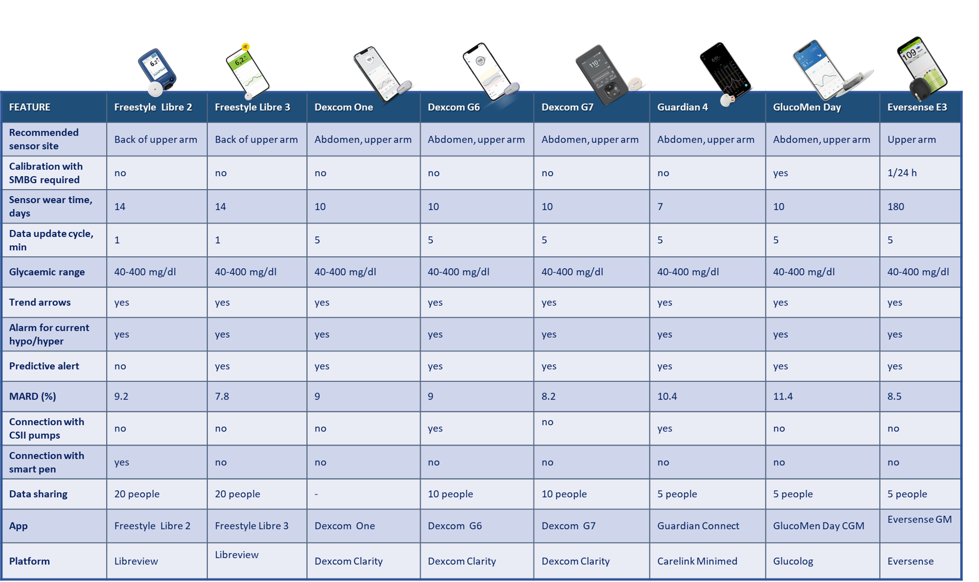
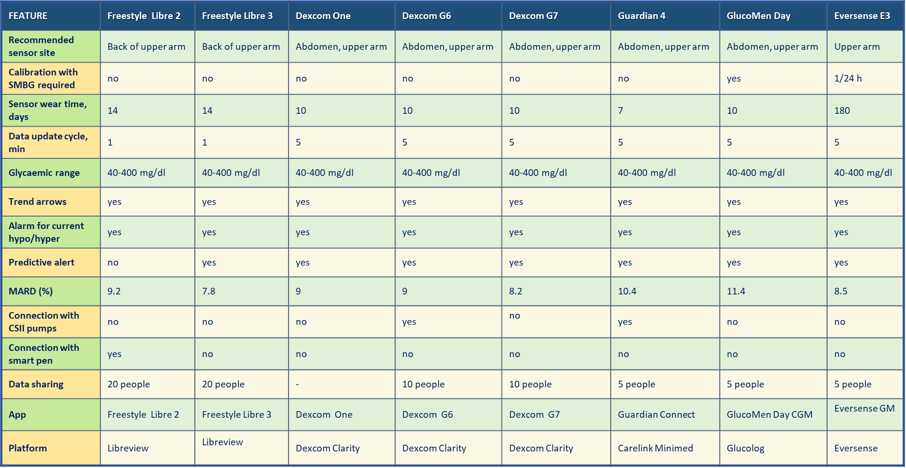

Slide 6
AACE Guideline update 2022, Endocr Pract. 2023

Slide 7
Continuous glucose monitoring devices
ADA-Standards of Care in Diabetes—2024

Slide 8
Summary of the market leading CSII models approved by the FDA together with their main features and specifications
Feliziani E.,…, Pozzilli P., Diab Res Clin Pract 2024

Slide 9
Challenges and limitation of technology: A list of the most common issues with possible solutions
Feliziani E.,…, Pozzilli P., Diab Res Clin Pract 2024

Slide 10
Continuous glucose monitoring devices interfering substances
ADA-Standards of Care in Diabetes—2024

Slide 11
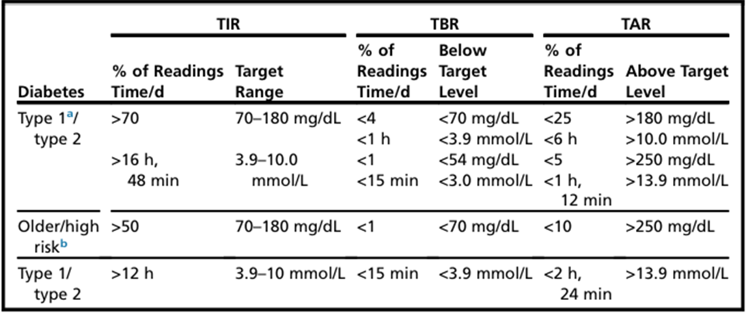
Targets for assessment of glycaemic control:
type 1/type 2 and older/high-risk individuals
Adapted from Battelino Tet al. Diabetes Care. 2019
Dovc K., Battelino T., Endocrinol Metab Clin N Am, 2020

Slide 12
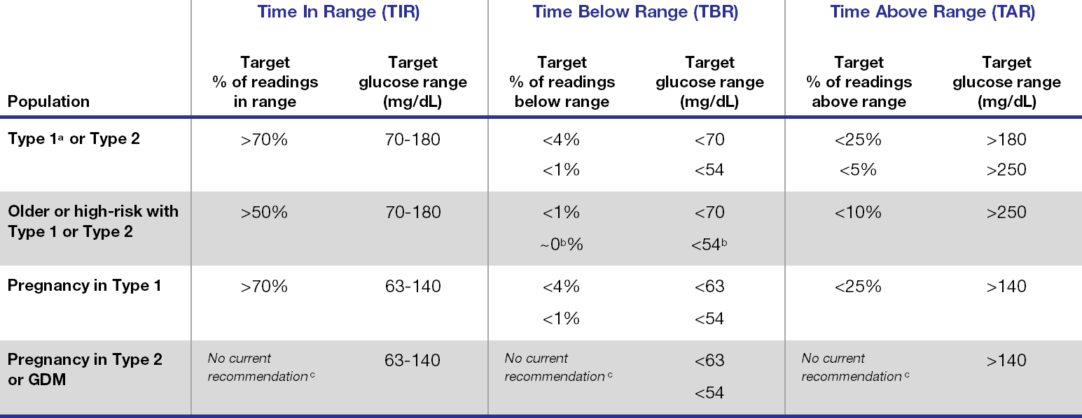
ADA and AACE consensus recommendations for glycaemic targets (percentage of CGM readings with corresponding target glucose range (mg/dL))
American Diabetes Association: Standards of Medical Care in Diabetes-2022
American Association of Clinical Endocrinology Clinical Practice Guideline-2021

Slide 13
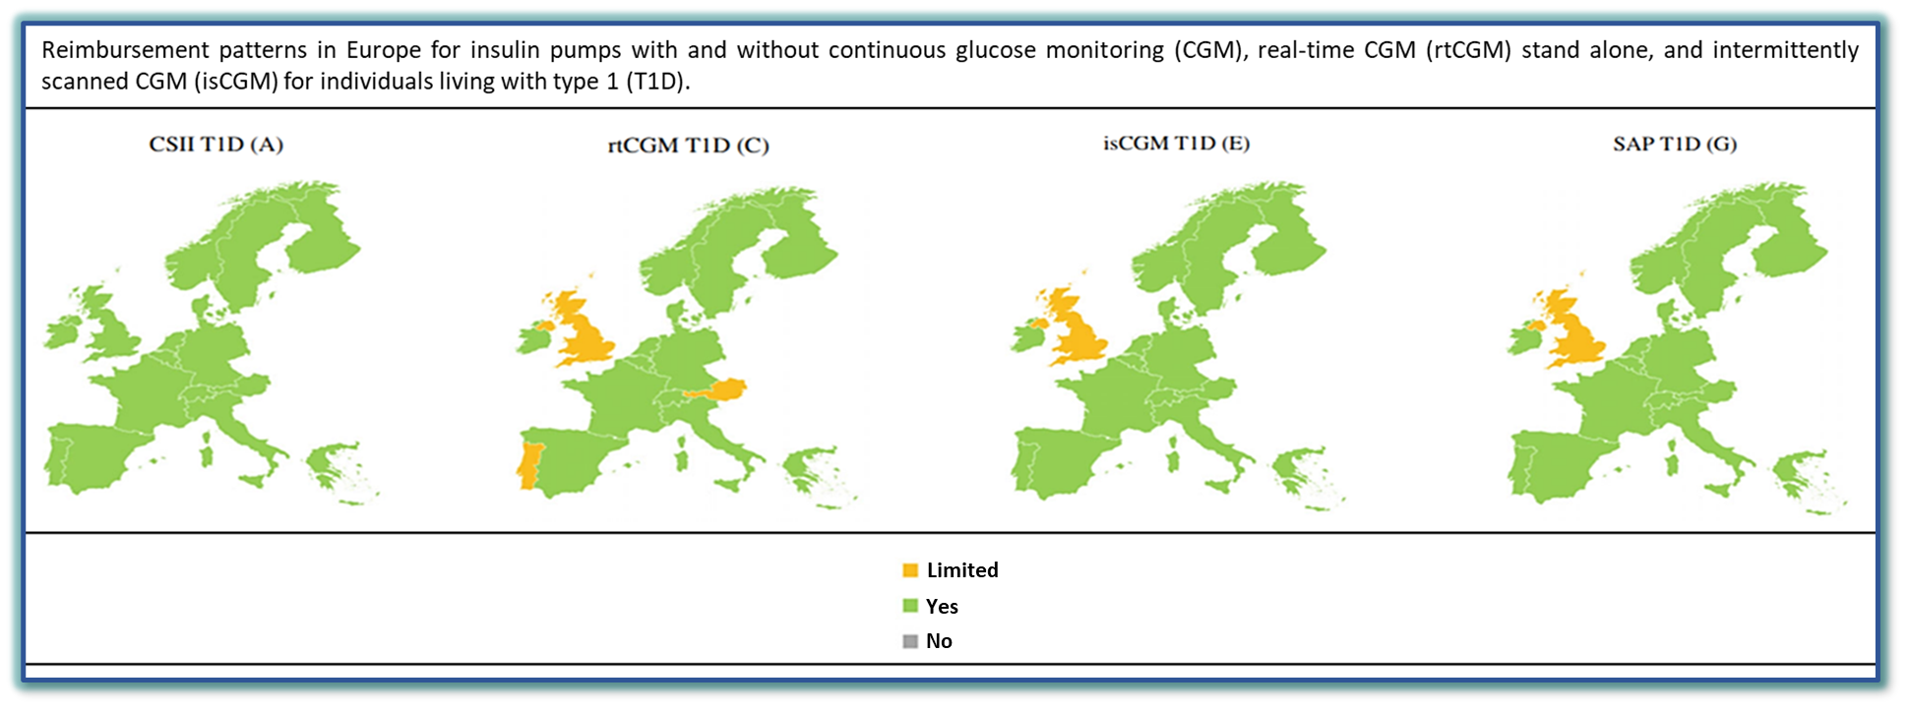
Use of insulin pumps and closed-loop systems among people living with diabetes: A narrative review of clinical and cost-effectiveness to enable access to technology and meet the needs of payers
Cost-effectiveness studies in T1D have shown that pump use is cost-effective in several countries, leading to improvements in quality-adjusted life-years. Insulin pumps are currently reimbursed for T1D in many European countries.
Jendle J et al., Diabetes Obes Metab. 2023

Slide 14
A 2-YEAR PILOT TRIAL OF CONTINUOUS SUBCUTANEOUS INSULIN INFUSION VERSUS INTENSIVE INSULIN THERAPY IN PATIENTS WITH NEWLY DIAGNOSED T1D. (IMDIAB 8)
The insulin requirement for the entire duration of the study, but not at entry and 3 months, was significantly higher in CSII compared with ISIT patients (0.62 +/- 0.4 IU/kg/day vs. 0.3 +/- 0.4 IU/kg/day, respectively; p<0.01).
After trial completion patients on CSII continued with this mode of therapy. Implementation of CSII as well as ISIT at diagnosis of Type 1 diabetes and continuation for 2 years thereafter achieved similar and optimal metabolic control, but more insulin was required with the CSII group.
Both types of intensive insulin therapy combined with NA are able to preserve C-peptide secretion or even increase baseline levels for up to 2 years after diagnosis.
Pozzilli P. et al., Diabetes Technol Ther. 2003

Slide 15
Trends of glucose, lactate and ketones during anaerobic and aerobic exercise in subjects with type 1 diabetes: The ACTION‐1 study
Physical activity after consuming a carbohydrate‐rich breakfast and with the omission of insulin, during a stepped maximal exercise test and a 1‐h continuous aerobic workout on an ergometer bicycle resulted in an increase of glucose and lactate both during exercise and recovery periods in people with T1D.
Ketones did not show any change during both tests, neither during exercise nor during recovery. Lactate, but not glucose or ketone AUC, was significantly higher in CPET compared to AEX.
Reducing fear of hypoglycaemia while exercising could result in more people with T1D being physically active. Continuous multibiomarker monitoring of glucose, lactate, and ketones may help to offer more individualised treatments, certainly in conditions where there is a large interindividual variability in these parameters.
De Ridder F,…, Pozzilli P., De Block C., Diabetes Metab Res Rev. 2022

Slide 16
Sustained Impact of Intermittently Scanned Continuous Glucose Monitoring on Treatment Satisfaction and Severe Hypoglycaemia in Adults with Type 1 Diabetes (FUTURE): An Analysis in People with Normal and Impaired Awarness of Hypoglycaemia
Data after 24 months of isCGM use in T1D adults show a sustained improvement of severe hypoglycaemia, hypoglycaemia coma, hospitalizations for hypoglycaemia, and work absenteeism,mostly driven by people with IAH.
Charleer S. et al., Diabetes Technol Ther 2023

Slide 17
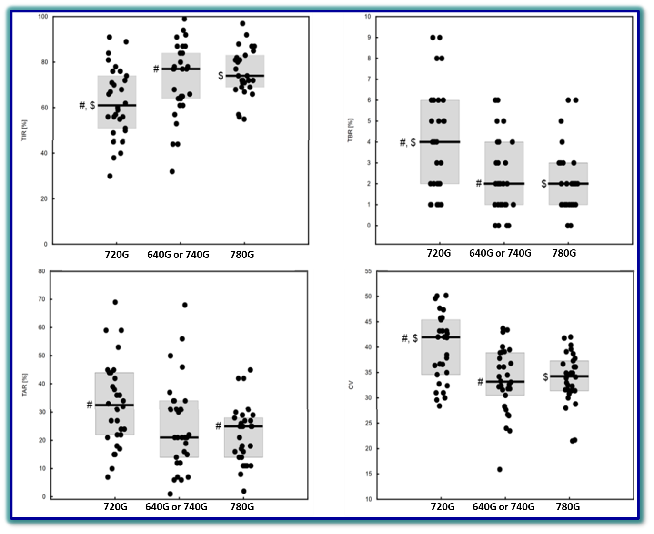
Comparison of Metabolic Control in Children and Adolescents Treated with Insulin Pumps
Any integration between the insulin pump and CGM was associated with better glycaemic control.
More advanced technologies and artificial intelligence in diabetes help patients maintain better glycemia by eliminating various factors affecting postprandial glycemia.
Lejk A. et al., Children 2024

Slide 18
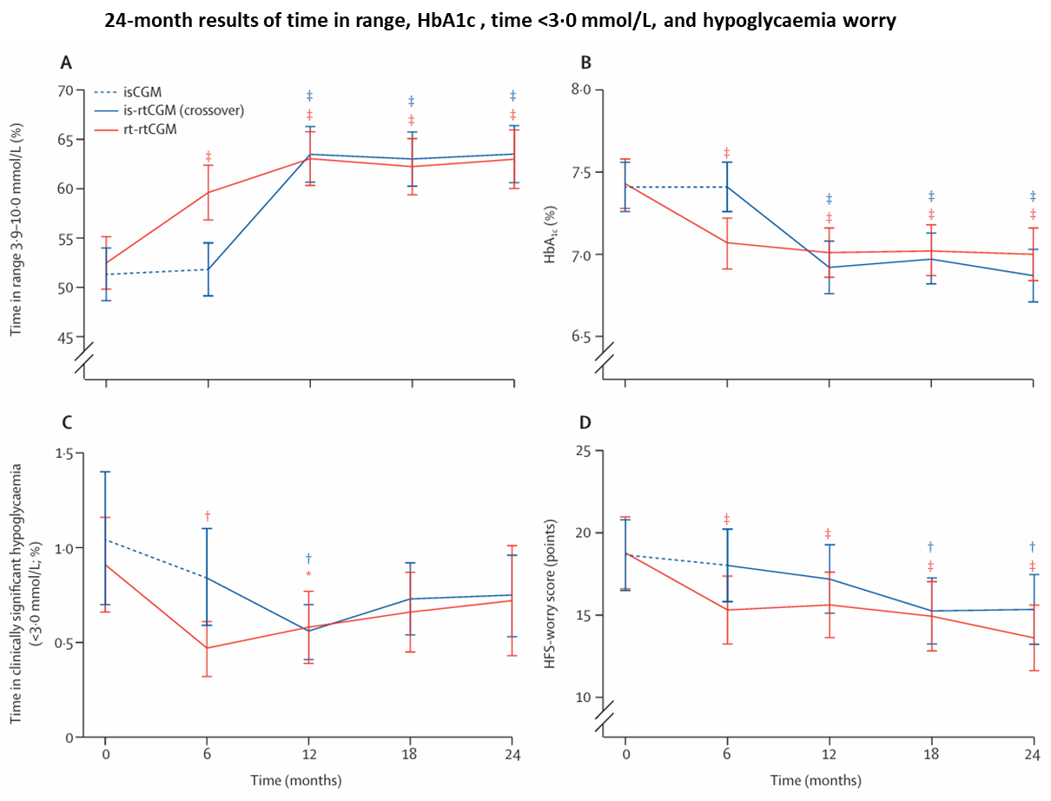
Effect of switching from intermittently scanned to real-time CGM in adults with T1D:
24-month results from the randomised ALERTT1 trial
Glycaemic control and hypoglycaemia worry improved significantly up to 24 months after switching from isCGM without alerts to rtCGM with alerts, supporting the use of rtCGM in the care of adults with type 1 diabetes.
Visser MM,…, Gillard P., Lancet Diabetes Endocrinol 2023

Slide 19
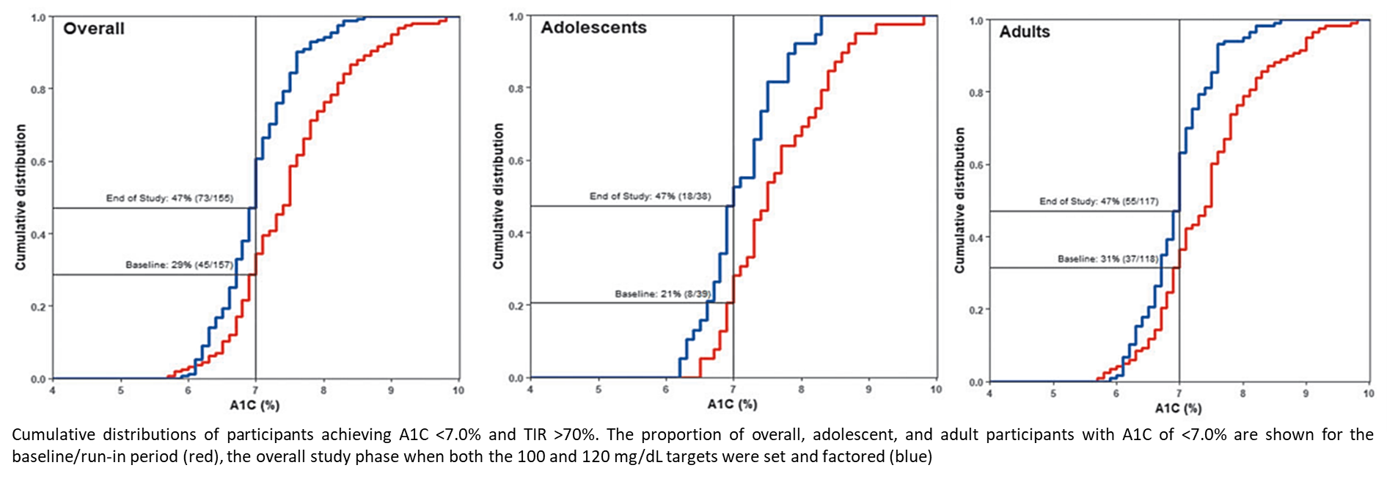
Safety and Glycemic Outcomes During the MiniMed Advanced Hybrid Closed-Loop System Pivotal Trial in Adolescents and Adults with T1D
These findings show that the MiniMed AHCL system is safe and allows for achievement of recommended glycaemic targets in adolescents and adults with T1D. Adjustments in target and AIT settings may further optimize glycaemia and improve user experience.
Carlson AL et al., Diabetes Technology and Therapeutics 2022

Slide 20
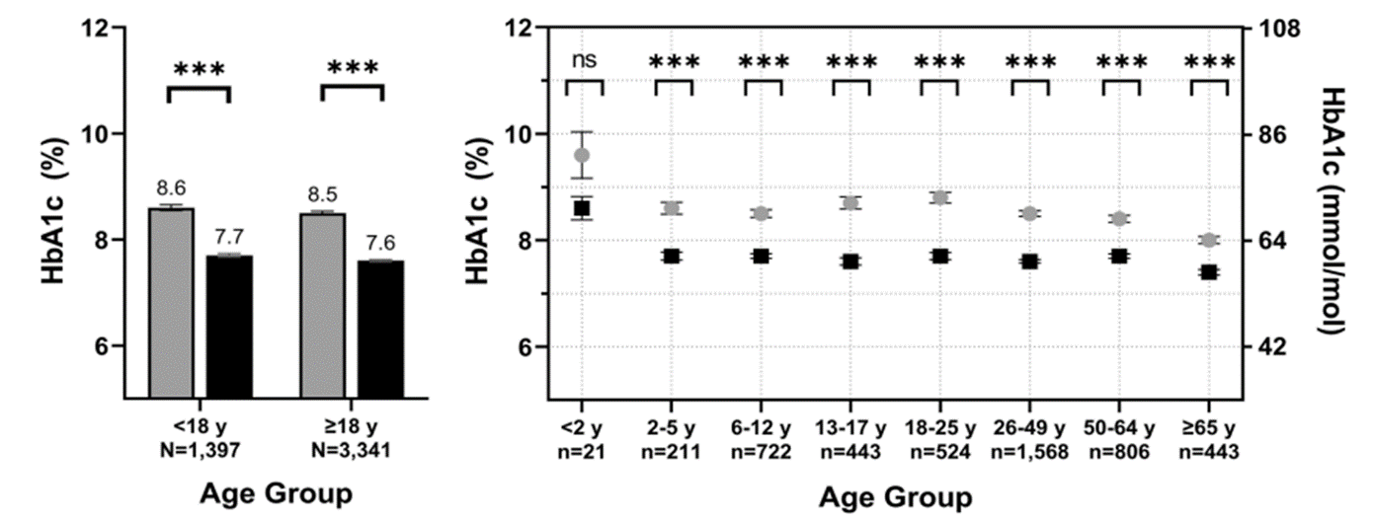
Improvements in Glycemic Outcomes in 4738 Children, Adolescents, and Adults with T1D Initiating a Tubeless Insulin Management System
Real-world study outcomes:
After 3 months of use of the Omnipod DASH System, HbA1c was significantly reduced, and patients reported a lower frequency of hypoglycemic events.
Total daily dose of insulin decreased among adults using the Omnipod DASH System.
Overall, these real-world outcomes provide positive evidence to support the use of Omnipod DASH as an option for people of all ages living with T1D.
Aleppo G. et al., Diabetes Ther. 2023

Slide 21
Evaluation of time in tight range and the glycaemia risk indexin adults with type 1 diabetes using an advanced hybrid closedloop system: A 1-year real-world assessment
The results highlight the sustained effectiveness of Tandem t:slim X2 with Control-IQ in improving glycaemic outcomes over 1 year and support the use of this technology for the management of T1D.
TITR, time intight range (70-140 mg/dL); GRI, glycaemia risk index
Rizzi A.,…, Pitocco D., Diabetes Obes Metab. 2024

Slide 22
Effects of switching from MiniMed™ 640G to 770G on CGM metrics and DTR-QOL scores: An observational study of Japanese people with T1D
Use of the MiniMedTM 770G improved continuous glucose monitoring metrics.
However, treatment satisfaction decreased, probably due to the increased frequency of blood glucose monitoring necessary to maintain auto mode.
Glycemic outcomes following continuous glucose monitoring. TIR 70–180 mg/dL, TAR >180 mg/dL, TAR >250 mg/dL, TBR <70 mg/dL, TBR <54 mg/dL are presented as the median. TAR >180 mg/dL includes percentages of values >250 mg/dL. TBR <70 mg/dL includes percentages of values <54 mg/dL.
Kogai T et al., J Diabetes Investig 2024

Slide 23
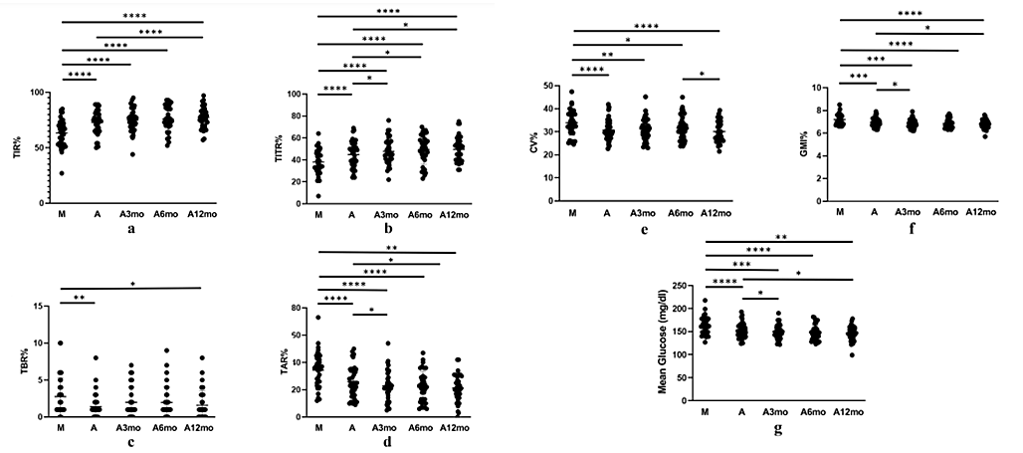
12‑Month Time in Tight Range Improvement with Advanced Hybrid‑Closed Loop System in Adults with T1D
The AHCL Minimed™ 780G system signifcantly enhances TITR, demonstrating continuous improvement throughout a 12-month follow-up period.
Nigi L.,…, Dotta F., Diabetes Ther 2024

Slide 24
Changing landscape of CGM coverage
CGM is recommended in everyone with diabetes who uses insulin (cfr ADA Standards of Medical Care 2023),
and according to the Endocrine Society, also in everyone on sulfonylurea.
More and more health insurance companies start following these guidelines:
The US: Since 17-4-2023, the FreeStyle Libre2 and the Dexcom G7 is reimbursed for people on Center for Medicare and Medicaid Services' (CMS) who are on insulin (1 or more injections per day) or have experienced a level 2 or 3 hypoglycemia. Both Abbott and Dexcom have developed a nice website for this large new population.
Canada: Since 27-4-2023, the Dexcom G6 is reimbursed for people on the Non-Insured Health Benefits (NIHB) program who use insulin (1 or more injections per day).
Wales: "In Wales, current guidance is that anyone on insulin should be eligible for intermittent CGM. It was presented to funders as an alternative to BGM that saves physician time." - Diabetes UK 2023

Slide 25
Conclusion I
•Diabetes technology is rapidly changing traditional care; safety, efficacy, and cost-effectiveness are driving reimbursement and adoption.
•Insulin pump use is associated with improved metabolic control, less glucose variability, less hypoglycemia, and improved quality of life.
•Continuous glucose monitoring is strongly associated with improved metabolic control, more time in range, less time in hypoglycemia, reduced anxiety, and improved quality of life; insulin-dosing advisors improve decision making.

Slide 26
Conclusion II
•Glucose-responsive automated insulin delivery, currently at the hybrid closed-loop stage, achieves the highest time in range, lowest hypoglycaemia, and favorable quality of life.
•Achievable targets for time in range and standard visualization of the continuous glucose monitoring data will help professionals and individuals with diabetes improve long-term outcomes with less disease burden; integrated decision support systems will further improve routine diabetes care.
•Data on bodyweight using new integrated systems for insulin and glucose monitoring are underestimated.
•Increase of bodyweight should be monitored keeping in mind that patients feel free to eat again as they were doing before T1D diagnosis.

